Slide 1
Face mask recognition

Slide 2
Content
Dataset
Neural Network
Optimization
Outlook

Slide 3
Dataset

Slide 4
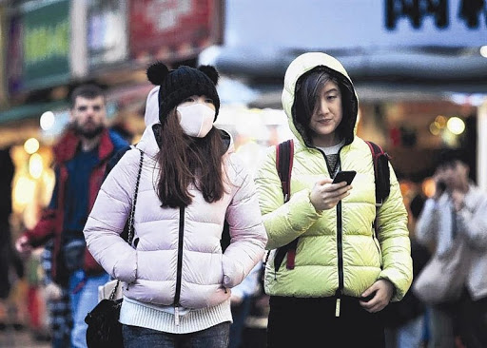
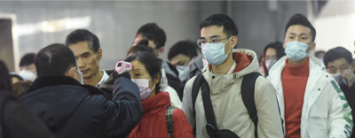
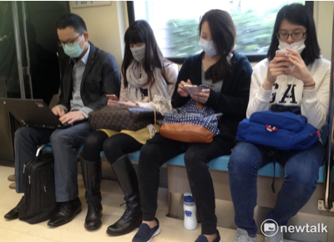
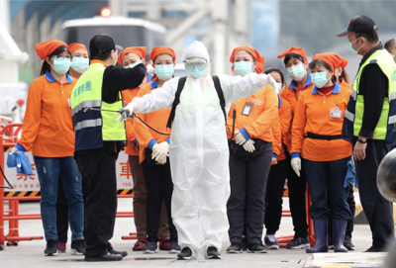
Dataset: https://www.kaggle.com/andrewmvd/face-mask-detection

Slide 5

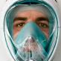
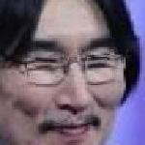

Dataset: https://www.kaggle.com/ashishjangra27/face-mask-12k-images-dataset
Data Split:
Train:
5.000 Mask
5.000 Non-Mask
Validation:
400 Mask
400 Non-Mask
Test:
483 Mask
509 Non-Mask

Slide 6
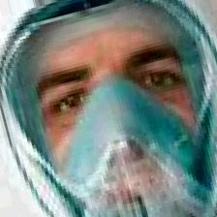
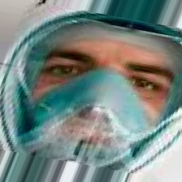
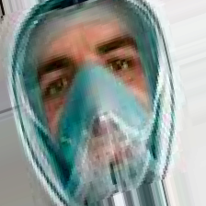
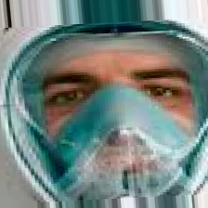
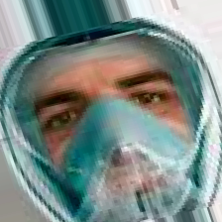
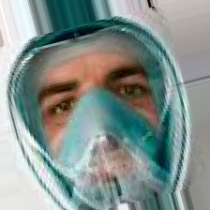

Slide 7
Neural Network

Slide 8
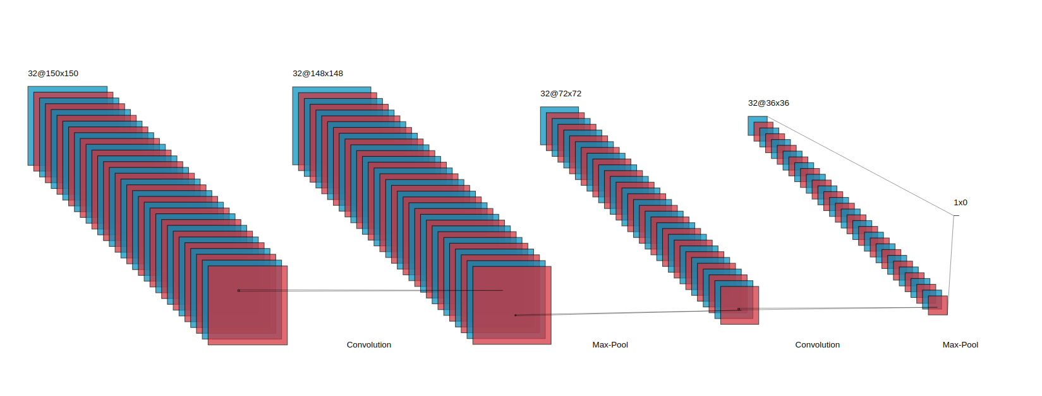
Model/Network

Slide 9
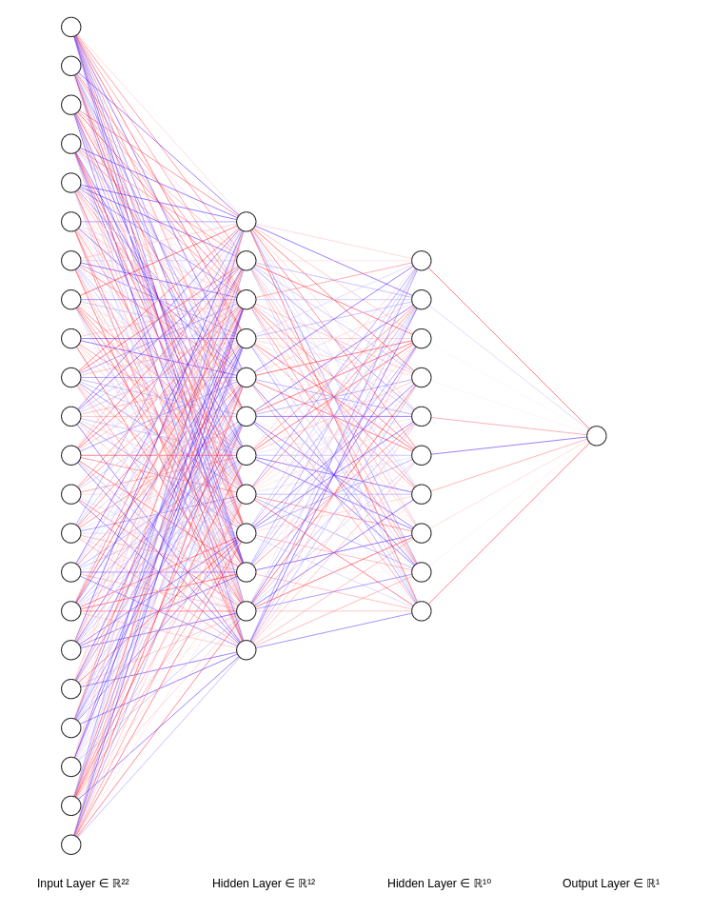
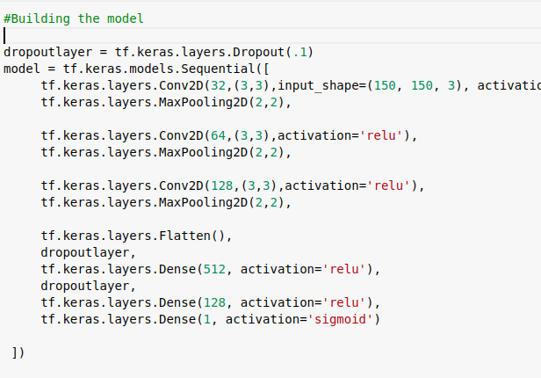
Model/Network

Slide 10
Basic Structure
Imports
Numpy, Matplotlib (As usual for plotting and calculations)
Tensor Flow (For creating model or neural network)
Os, Cv2(for image reading), Pickle(for serialization)
Model/Network
Conv2D layer, we used it to condense the image down to the important features that distinguish what makes it a mask or no mask.
MaxPooling2D, we used it for compressing the image,it will preserve the features that were highlighted by Conv2D layer, while simultaneously quartering the size of image.
We used another Conv2D layer so that network can learn another set of convolutions on the top of existing one and then again pool to reduce size.
Flatten layer,It just takes the dimensions of image received from MaxPooling2D and convert it into one dimensional array.
Dense layer,it gets the one dimensional array from flatten layer tries to provide the correct output on the basis of function (SIGMOID), weather the person in picture is wearing mask or not.

Slide 11
Basic Structure(Cont)
Callbacks
on_epoch_end, as the name suggest its called when an epoch ends and we defined the ending condition if the accuracy reached 99% then terminate process.
Image Generator
To create feeder for images and label them.
Rescale to normalize the data
Earlystopping Callback
We are using it for overcoming overfitting by patience of 3.

Slide 12
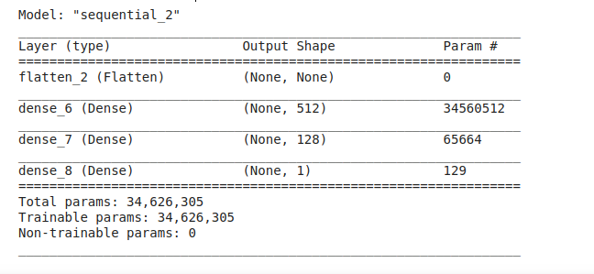
Model Summary (initial Setting)

Slide 13
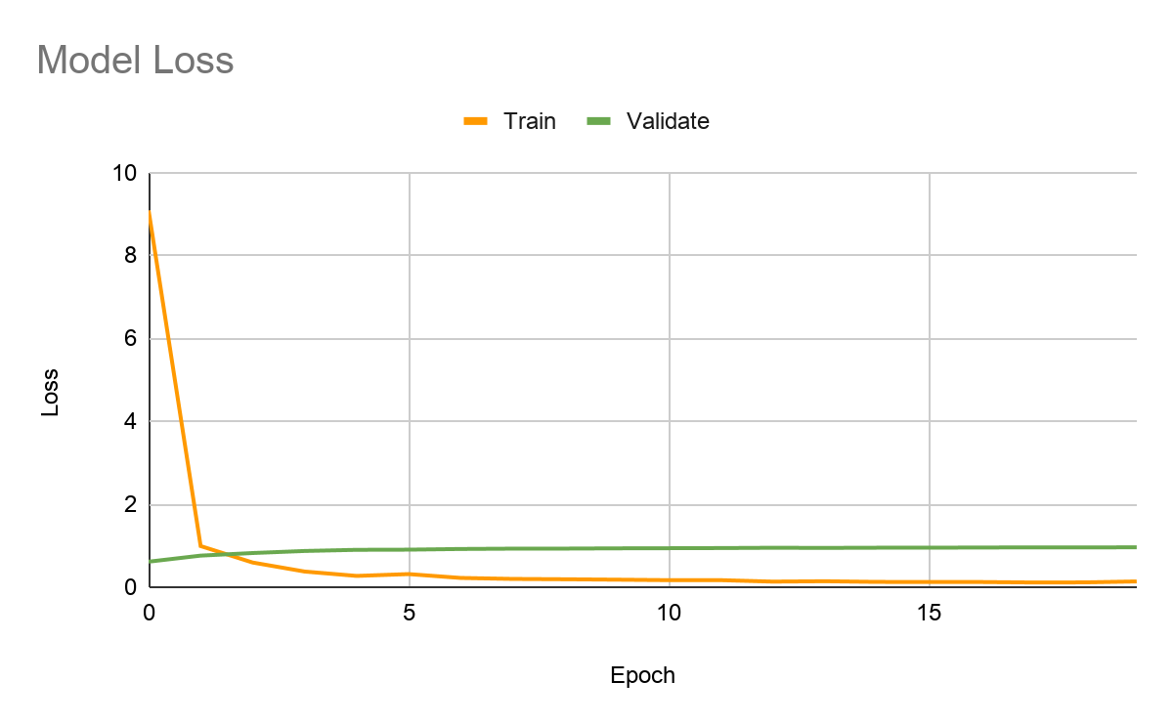
First Results

Slide 14
Optimization

Slide 15
Optimizers
20 epochs on the base model
3 different optimizations
SGD
𝛽 = 0.9
RMSprop
𝛽 = 0.9
No Momentum
Adam
𝛽₁ = 0.9
𝛽₂ = 0.999

Slide 16
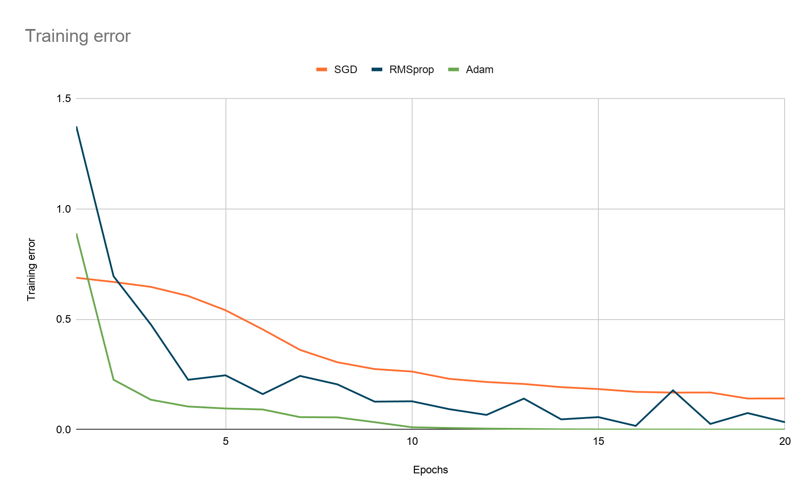
Optimizers: Comparison of the training error

Slide 17
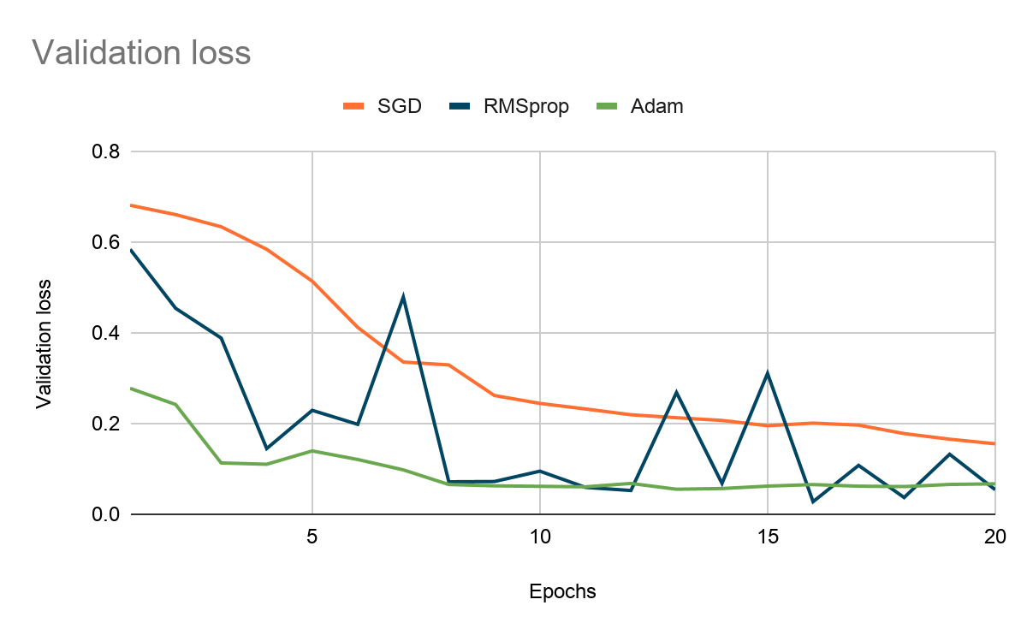
Optimizers: Comparison of validation loss

Slide 18
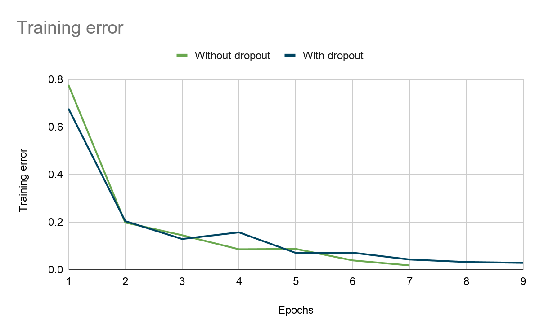
Using dropout layers

Slide 19
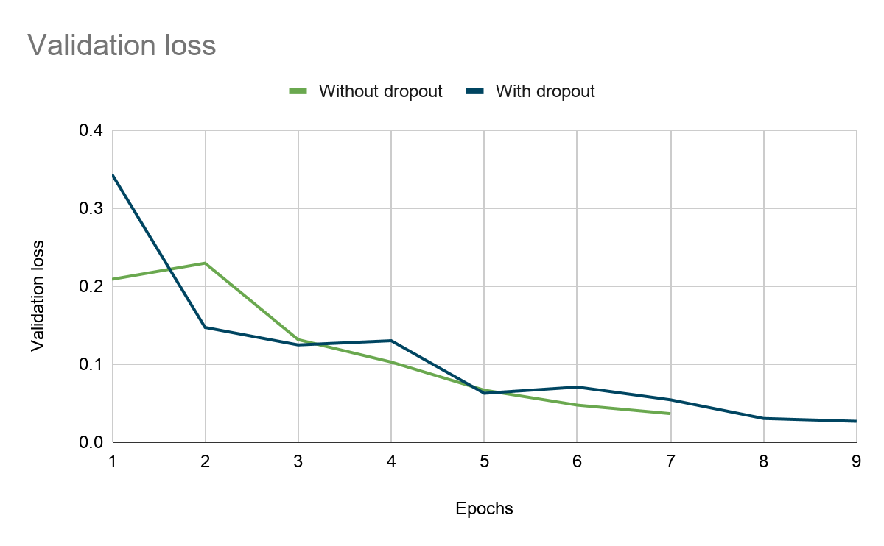
Using dropout layers

Slide 20
Using dropout layers
 | Without dropout layers | With dropout layers
Test accuracy | 0.99 | 1.00
Training duration | 634 sec. (7 epochs) | 40 sec. (9 epochs)

Slide 21
Outlook

Slide 22
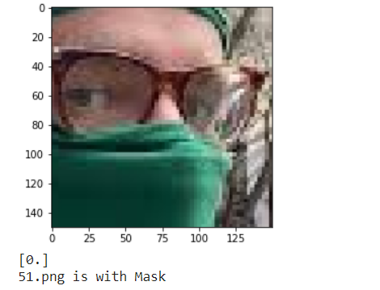
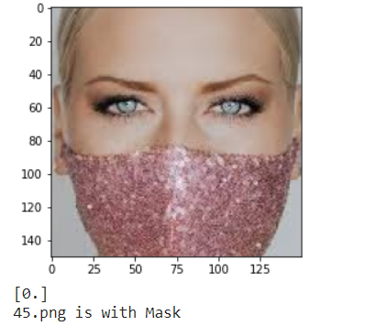
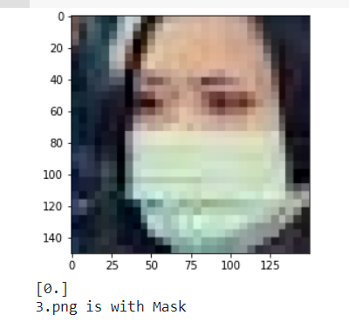
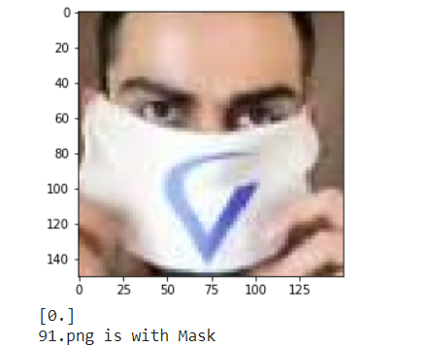
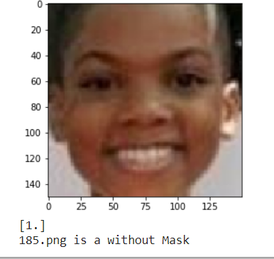
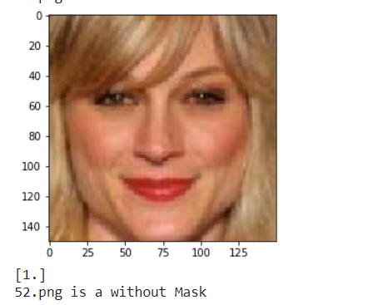
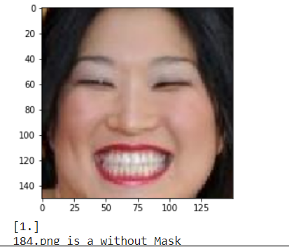
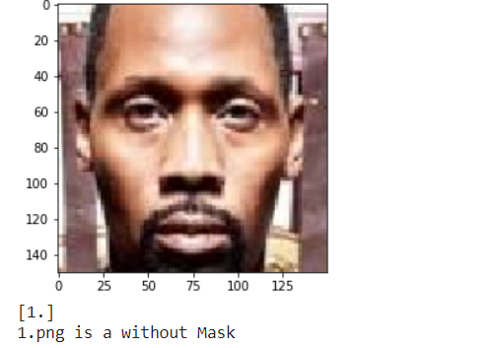
Model Prediction

Slide 23
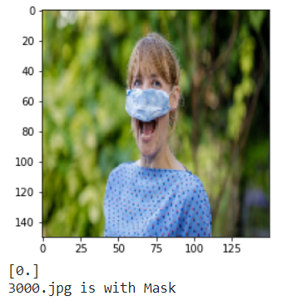
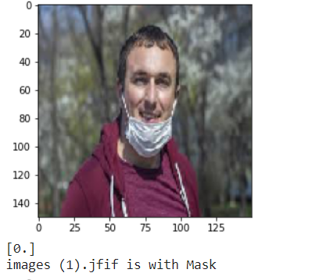
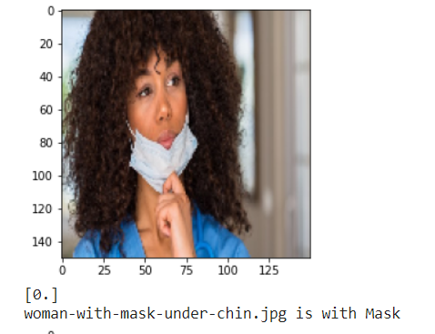
Wearing Mask but no correct

Slide 24
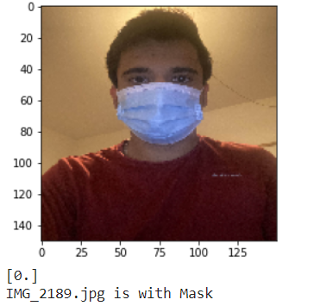
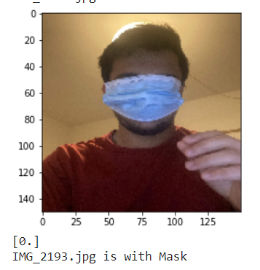
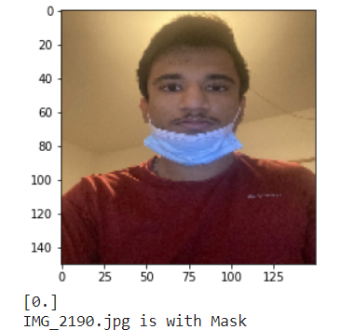
Testing Own Picture Wearing Mask

Slide 25
Content
Data
Unsuitable data
Finding best data
Image augmentation (Image data generator)
Neural Network
Basic structure of the notebook (TF-Keras)
First results (restoring first version by removing the optimizations)
Optimizations: Using graphs comparing the results with and without each of the given optimizations. (exports graph data and re-use in this presentation.)
Reducing epochs (early stopping)
RMS to Adam
Dropout-Layers (to prevent overfitting)
Outlook
Other kinds of images (showing different objects)
Images in different resolutions
Wearing a mask but not correct
Bennet (create kind of a template)
Adnan
Ravish
Christoph

